Slide 1
Virtual Cloud Storage
Reduce the lifetime costs of storing, protecting and
accessing compliance data in the cloud, as much as 80%

Slide 2
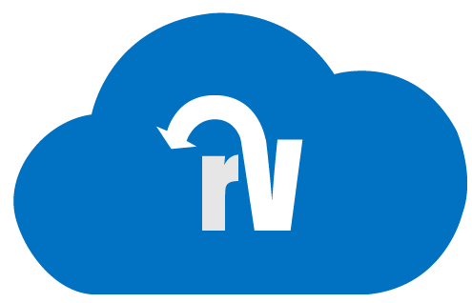
Introducing restorVault
restorVault is a cloud storage company focused on retaining and protecting compliance data.
Our solution provides superior protection, ultra-fast recovery, and on-demand access while reducing on-prem and cloud storage costs up to 80%.
Compliance Assured
Notes:
We store and protect compliance data in the cloud, more securely with 80% lower costs than conventional cloud storage from AWS, Azure etc.

Slide 3
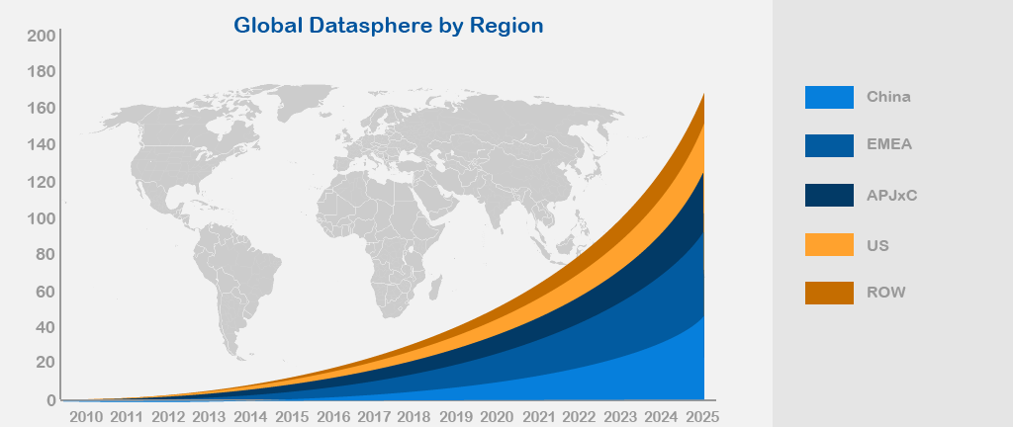
Data is growing 61% per year
But cloud storage prices are only falling 5-10% per year
Cloud Storage Market has a CAGR of 25%. Enterprise cloud storage pricing is only falling 5-10% per annum.
Rising storage costs is a growing concern – especially for compliance data with long retention times, if it is not being utilized in some way.
90% of unstructured data is inactive. You should not have to pay premium rates to store it in the cloud.
61%
CAGR
Source: IDC Data Age Report sponsored by SeaGate

Slide 4

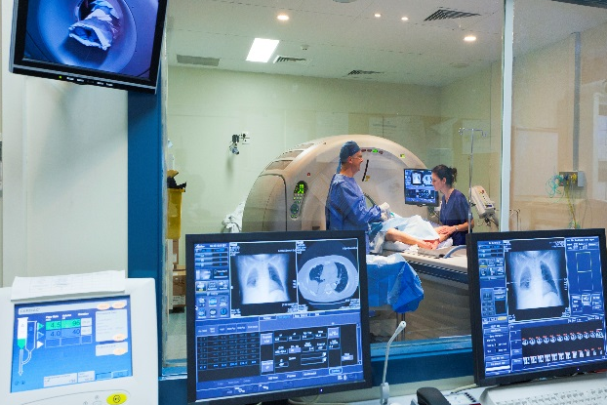


Industries and Applications Most Impacted
ECM
EHR / PACS
Legal and Forensic
Video Surveillance
Unstructured information
Digitizing, scanning, archiving paper and electronic files which may contain PII info, and having retention times up to 30 years
$41 Bn Global
$14 Bn N. America
13% Growth Rate
Enormous file sizes
Very large image files and massive radiology datasets which are doubling in acuity (and size) every 2-3 years
$30 / $3.3 Bn Global
$10 / $1.2 Bn N. America
8% Growth Rate
Stringent regulations
Case data including body worn camera video, CCTV, and other admissible evidence requiring chain-of-custody compliance
$8 Bn Global
$3.2 Bn N. America
15% Growth Rate
High resolution video
Industry transitioning from analog systems to IP based digital systems with remote cloud access and control
$45 Bn Global
$12 Bn N. America
10% Growth Rate

Slide 5
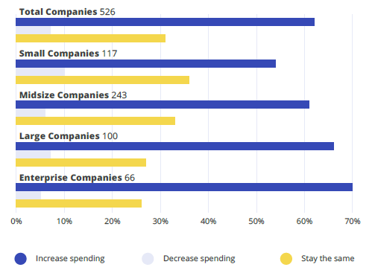
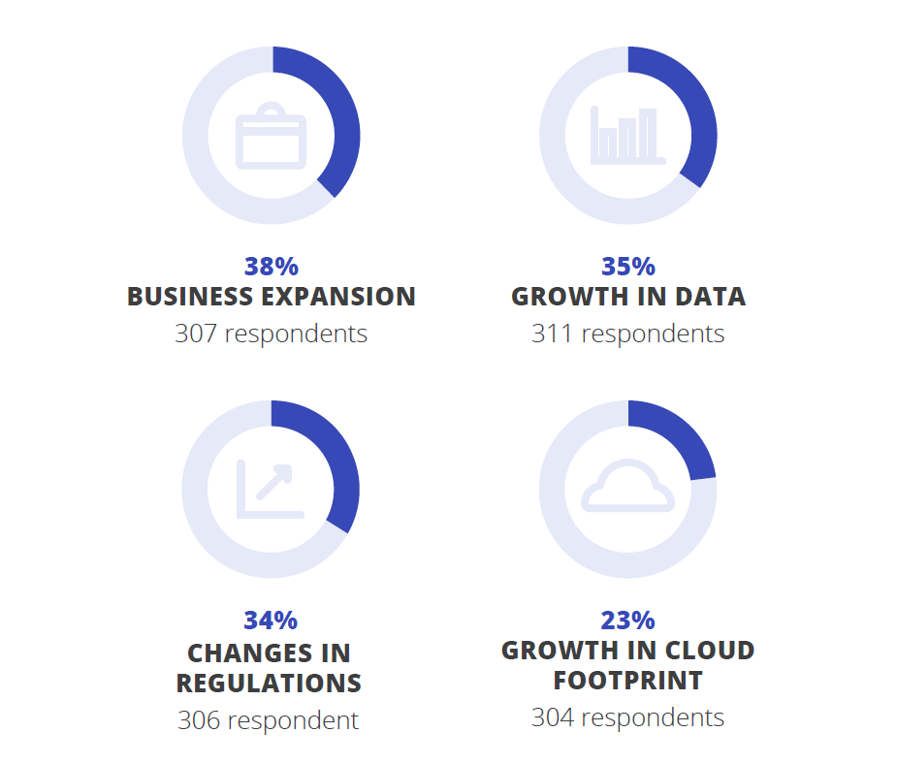
Compliance Data Growth next 12-24 months
55-70% expect increased spending
Spending growth drivers
Source: https://hyperproof.io/resource/compliance-statistics-2020/

Slide 6
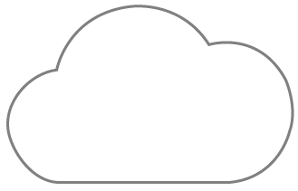


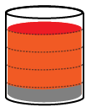







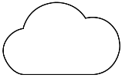
Storage Challenges for compliance data
CAPTURE
DELIVER
$
$
$
$
$
STORE
MANAGE
DR
TRAINING
WEB
QA / DEV
PRESERVE
80%-90% of data is inactive
Local storage being wasted
Cloud copies very expensive

Slide 7
How does restorVault assure ECM compliance with 80% lower costs?

Slide 8

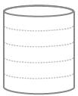
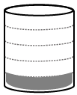
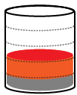
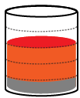



Public Cloud Storage
OS, Db and Data ghosted to the Cloud
ON PREM / PRODUCTION
CLOUD BUSINESS OPERATIONS
DR
PROVIDER 1
BACKUP SOFTWARE
QA
PROVIDER 2
DEV
TRAIN
OS
Db
Data
Notes:
This is an Opex heavy model.
In this deployment model you ghost entire servers to the cloud, where you rent compute and storage.
But if 80% of your data is mostly inactive unstructured data, every time you replicate the data for different use cases, such as training and disaster recovery, you are duplicating the static data again and again which is highly wasteful of capacity.
So long as you trust it is impossible to alter, damage or erase an image, how many copies of it do you REALLY need?
Over time, the Opex is high and tends to grow, because the growth in data outstrips the fall in storage prices.

Slide 9

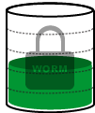
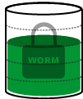

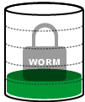
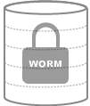
Public Cloud Storage with restorVault
OS, Db and ghosted to the Cloud, unstructured data moved to rV
ON PREM / PRODUCTION
CLOUD BUSINESS OPERATIONS
DR
PROVIDER 1
PROVIDER 1
BACKUP SOFTWARE
QA
PROVIDER 2
DEV
FSW POLICY
MANAGER
TRAIN
CCA / SCB
OS
Db
Data
Protected Data
VDF

Slide 10

restorVault – Compliance Assured
Trusted Systems compliant storage
  Immutable storage, Impervious to ransomware
  Assured data integrity with redundant copy
500x faster recovery and copy data
  Only need to handle VDFs not original data
  Restores 800 VDFs / sec vs 5-10 files / sec
  Recover from disaster, or spin up new server
Up to 80% lower storage costs
  Frees up capacity on primary and cloud servers
  No data recovery or lock-in fees from rV
1 GB
HOW IS
THIS →
1 TB
BETTER
THAN
THIS →
PROVIDER 1

Slide 11
Trusted Systems compliant storage
Unprotected storage: Files can be edited & deleted without trace.
Protected, audited storage:
Files can never be altered and may only be deleted per h/w enforced retention policies.
No file protection:
Permissions: ALL
Added file protection:
Permissions: WORM
+ Fingerprint
+ Time stamped
+ Auto verified
+ Serial numbered
+ Duplicated
+ Audit trail
+ VDF
Trusted
Systems
Compliant
$0.12/Gb
$0.15/Gb
Vulnerable File System: Ransomware attacks file systems, so this backup can also be attacked.
No File System
Object storage which is impervious to ransomware
DUPLICATE IN
REDUNDANT
DATA CENTER
Notes:
How is your Cloud “backup” safer in our Vaults?

Slide 12
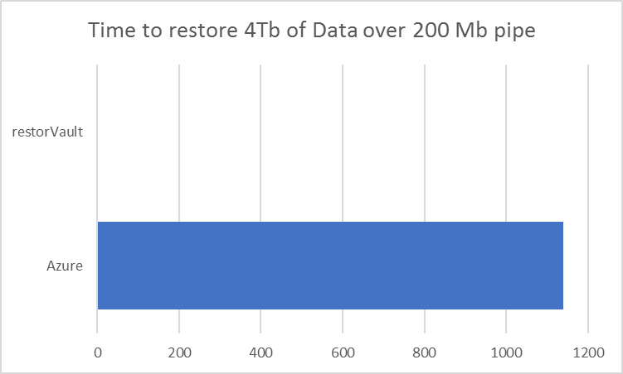
500x faster disaster recovery and copy data
4 Tb unstructured data locked-out by ransomware attack
  Total of 800,000 files restored, with average file size of 5 Mb
DataCenter Bandwidth | Conventional Cloud Backup and Restore | With restorVault
50 Mbps | 10,800 mins | 8.5 mins
200 Mbps | 1,410 mins | 2.2 mins
TWO MINUTES
TWO DAYS
Over 500x faster even with big internet connections
Notes:
As we mentioned earlier, availability has to do with how quickly after a failure or ransomware attack a company’s data can be restored from a backup and the system can return to full operation.
Having a backup is great, but if it takes forever to restore it to the primary server, a company can still be severely compromised and suffer enormous reputational and lost opportunity costs. Security magazine estimated the average downtime costs of a ransomware attack for companies at $141,000 in 2019.
Let’s take a typical example… a company that has 4 Terabytes of unstructured data – say roughly 800,000 files of 5 MBytes each. And let’s assume they have a cloud backup of all that data, but then they suffer a primary server failure or ransomware attack. They’re protected, because they have the backup, but they now have to download that entire 4 Terabytes of data over their internet connection.
If they have a typical 50 mega bits per second connection, it will actually take OVER 7 DAYS to re-download all that data! And during that time they are effectively off-line and non-operational.
Even if the company has a high speed connection of 200 mega bits per second, it will still take ALMOST 2 FULL DAYS to download the data.
These are not just arbitrary examples. There are cases reported in the news with some frequency where companies have taken multiple days to up to a full week of more to restore operations following an attack.
By comparison, with restorVault, the restore process involves downloading the much smaller Virual Data Files or VDFs, and as soon as they are all downloaded, the system is again operational. For the above example, a restore under a restorVault system can be accomplished in a matter of minutes.
RestorVault reduces restore and recovery times by 500 to 1000x, helping get businesses back up and running without significant delay, and saving them the many costs of multi-day downtime.

Slide 13
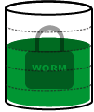

Up to 80% lower storage costs
BEFORE
AFTER
$
$
$
$
$
$
PRIMARY
ECM
STORAGE
DR
TRAINING
WEB
QA / DEV
PRIMARY
ECM
STORAGE
DR
TRAINING
WEB
QA / DEV
Cloud copies very expensive
Local storage filling up fast
Vulnerable to ransomware
Up to 80% less storage needed
Local storage lifespan extended
Immutable, redundant data vaults

Slide 14




Virtual Cloud Storage Summary
SECURE DATA RETENTION
VIRTUALIZED DATA ACCESS
Compliant Cloud Archive
(CCA)
Secure
Cloud Backup
(SCB)
Offload Data
Virtualization
(ODV)
Copy Data
Virtualization
(CDV)
Long-term cloud archive
for long-retention and retrieval of compliance data, that may not be altered.
Hot standby cloud backup for high-value unstructured data backup with complete disaster recovery in mins.
Free-up primary storage by virtualizing inactive data retained and protected in a CCA or SCB vault.
Access CCA/SCB copy data for business functions such as Q/A, Dev, Training, DR, without using more storage
Superior protection and faster recovery
Capacity savings driving 80% lower costs

Slide 15
Cloud Storage Comparison
 | ON-PREMISE STORAGE | CONVENTIONAL CLOUD | CLOUD with RESTORVAULT
CAPITAL COST | HIGH | LOW | LOW
OPERATING COST | LOW | HIGH | LOW
COPY DATA COST | HIGH | HIGH | LOW
DATA LOCK-IN FEES | NO | YES | NO
RANSOMWARE IMMUNITY | NO | NO | YES

Slide 16
SPARE SLIDES
More Details / Other Points

Slide 17
Virtual Cloud Storage Use Cases
SECURE DATA RETENTION
VIRTUALIZED DATA ACCESS
Superior protection and faster recovery
Capacity savings driving 80% lower costs
Compliant Cloud Archive
Secure
Cloud Backup
Offload Data
Virtualization
Copy Data
Virtualization

Slide 18



Vaults: two secure data retention methods with differing versioning and retention policies
SECURE DATA RETENTION
Superior protection and faster recovery
Compliant Cloud Archive
(CCA)
Secure
Cloud Backup
(SCB)
Long-term cloud archive for long-retention and retrieval of compliance data, 100% immutable.
Snapshot from primary then all net-new files
Legal retention 7-30 years
Automatic retention policies
Impervious to ransomware
Compliance audit trail
Hot standby cloud backup for high-value business data backup with full disaster recovery in mins.
Snapshot from primary then incremental backups
30 day version regression
100x faster DR that usual
Impervious to ransomware
No data recovery fees

Slide 19


Access: two ways to virtualize access to data retained and protected in CCA/SCB vaults
VIRTUALIZED DATA ACCESS
Capacity savings driving 80% lower costs
Offload Data
Virtualization
(ODV)
Copy Data
Virtualization
(CDV)
Free-up primary storage by virtualizing inactive data retained and protected in CCA/SCB vaults.
Inactive data is off-loaded & replaced with VDFs
Only active files stay local
Conserves primary capacity
Immutable, instant access
Prolongs system lifespan
Access CCA/SCB copy data for other use cases: Q/A, Dev, Training, DR, without more storage.
VDFs on new servers virtualize a copy of the data
Spin up new servers in mins
Use 80% less cloud storage
More copies, more savings
Fraction of usual costs

Slide 20
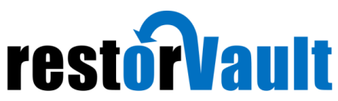
Lower storage, backup and copy data costs
44% saving
this example
Expect extra charges
for data in and out
above a threshold
Unlimited
data in and out
5-YEAR SAVINGS $50,000

Slide 21
ECM Before and After restorVault (with Local Backup)
BEFORE
AFTER
$
$
$
$
$
$
PRIMARY
ECM
STORAGE
Local
Backup
DR
TRAINING
WEB
QA / DEV
PRIMARY
ECM
STORAGE
Local
Backup
DR
TRAINING
WEB
QA / DEV
Cloud copies very expensive
Local storage filling up fast
Vulnerable to ransomware
Up to 80% less storage needed
Local storage lifespan extended
Immutable, redundant data vaults

Slide 22




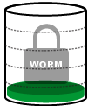
restorVault Offload Data Virtualization (ODV)
Conserves primary storage capacity – Inactive unstructured data moved to rV
ON PREM / PRODUCTION
CLOUD BUSINESS OPERATIONS
PROVIDER 1
PROVIDER 1
BACKUP S/W
BACKUP SOFTWARE
PROVIDER 2
OFFLOAD
2TB
FSW POLICY
MANAGER
OS
Db
Data
Protected Data
VDF

Slide 23




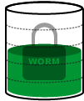
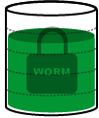
restorVault Offload Data Virtualization (ODV)
Conserves primary storage capacity – Inactive unstructured data moved to rV
ON PREM / PRODUCTION
CLOUD BUSINESS OPERATIONS
PROVIDER 1
PROVIDER 1
BACKUP S/W
BACKUP SOFTWARE
PROVIDER 2
2TB
FSW POLICY
MANAGER
4TB
OS
Db
Data
Protected Data
VDF

Slide 24
restorVault Copy Data Virtualization (CDV)
Replicate systems multiple times, with almost zero additional cloud storage
ON PREM / PRODUCTION
CLOUD BUSINESS OPERATIONS
QA
DR
BACKUP SOFTWARE
QA
DR
DEV
FSW POLICY
MANAGER
TRAIN
CCA / SCB
OS
Db
Data
Protected Data
VDF

Slide 25



restorVault Copy Data Virtualization (CDV)
Replicate systems multiple times, with almost zero additional cloud storage
ON PREM / PRODUCTION
CLOUD BUSINESS OPERATIONS
WEB
DR
BACKUP SOFTWARE
QA
TRAIN
DEV
FSW POLICY
MANAGER
DEV
TRAIN
OS
Db
Data
VDF

Slide 26
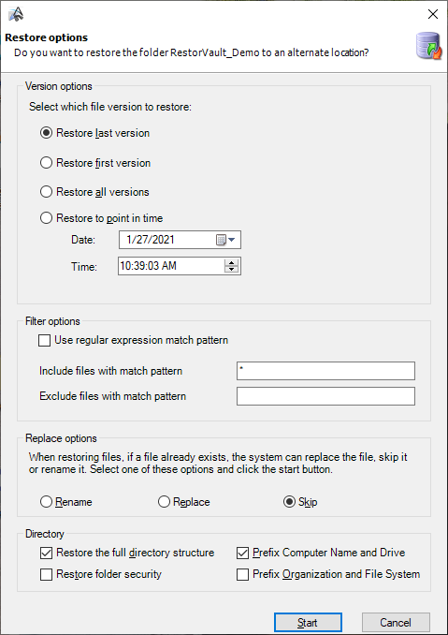
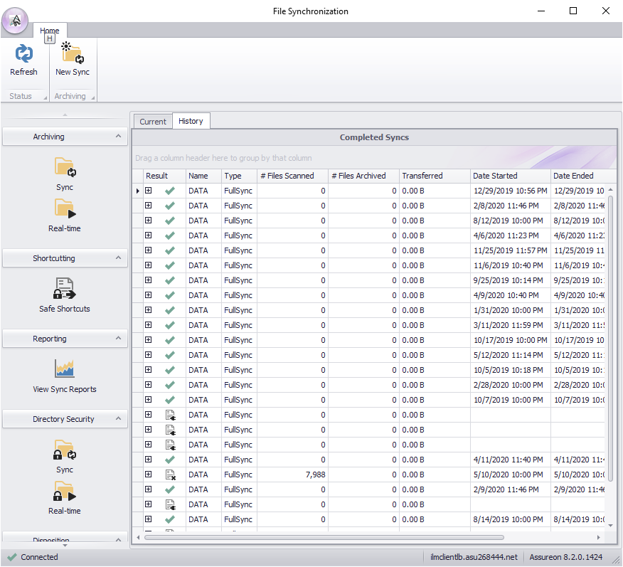
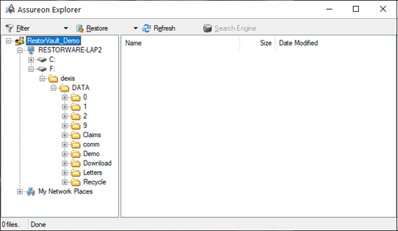
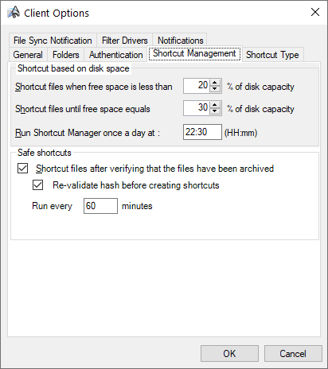
restorVault FSW and Policy Manager
Notes:
Describe the software components
File System Watch
Assureon Sync
Assureon Explorer
See what files exist on the volume and restore any item
Policy Manager
SPEAK TO THE TAB FUNCTION in the Client options screen
Backup or not backup
Identical copy of original in backup
Virtualize or not virtualize
Original is now a VDF
Schedule timing and frequency or on-demand

Slide 27
Prem to Cloud Template
Notes:
This is an Opex heavy model.
In this deployment model you ghost entire servers to the cloud, where you rent compute and storage.
But if 80% of your data is mostly inactive unstructured data, every time you replicate the data for different use cases, such as training and disaster recovery, you are duplicating the static data again and again which us highly wasteful of capacity.
So long as you trust it is impossible to alter, damage or erase an image, how many copies of it do you REALLY need?
Over time, the Opex is high and tends to grow, because the growth in data outstrips the fall in storage prices.

Slide 28


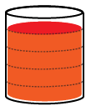
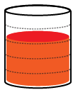
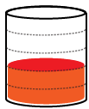
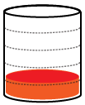



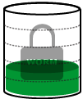


Icons
Clouds (size 80%)
User 1
User 2
Empty Storage Disk (size 60%)
Data Storage Disks
(size 60%)
VDFs and Data Base Storage Disks
(size 60%)
Data and Database Storage Disks
(size 60%)
VDFs, Data Base and Data Storage Disks
Protective Data Storage Disks (size 60%)
CCA
SCB
ODV
CDV
Data Icons
Compute with Operating System
VDF
OS
Data
Db

Slide 29
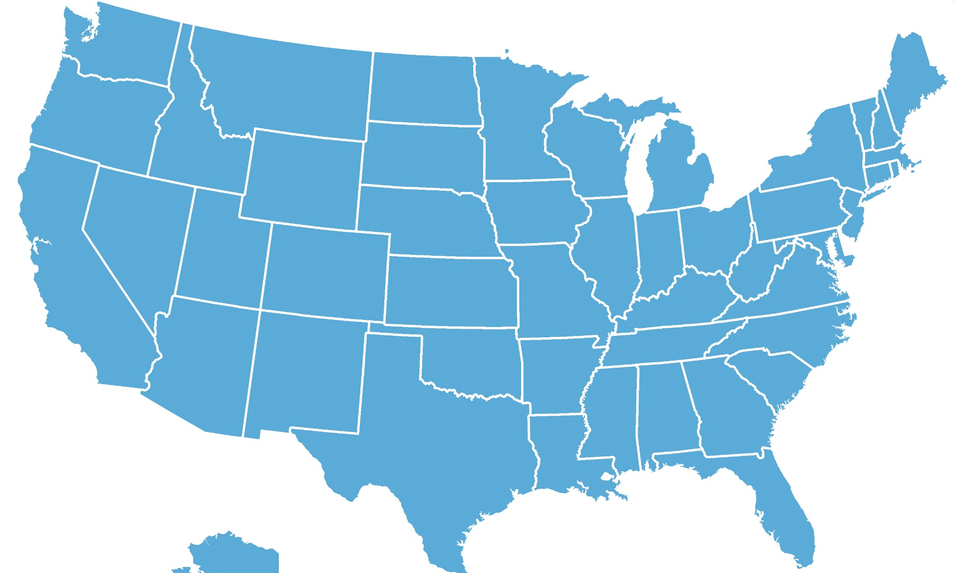
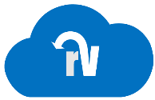
restorVault redundant data centers
We maintain a redundant copy of all data in our network
  Cross verified, Auto corrected, Fingerprinted,
How is client data protected from unauthorized access?
ARLINGTON, VA
Iron Mountain
SAN DIEGO, CA
ScaleMetrix
PHOENIX, AZ
Iron Mountain

